Slide 1


Slide 2
Modern javascript
ES6

Slide 3
Block Scope
Variable Hoisting
Block Scope
# const datatype is also have property of block scope.

Slide 4
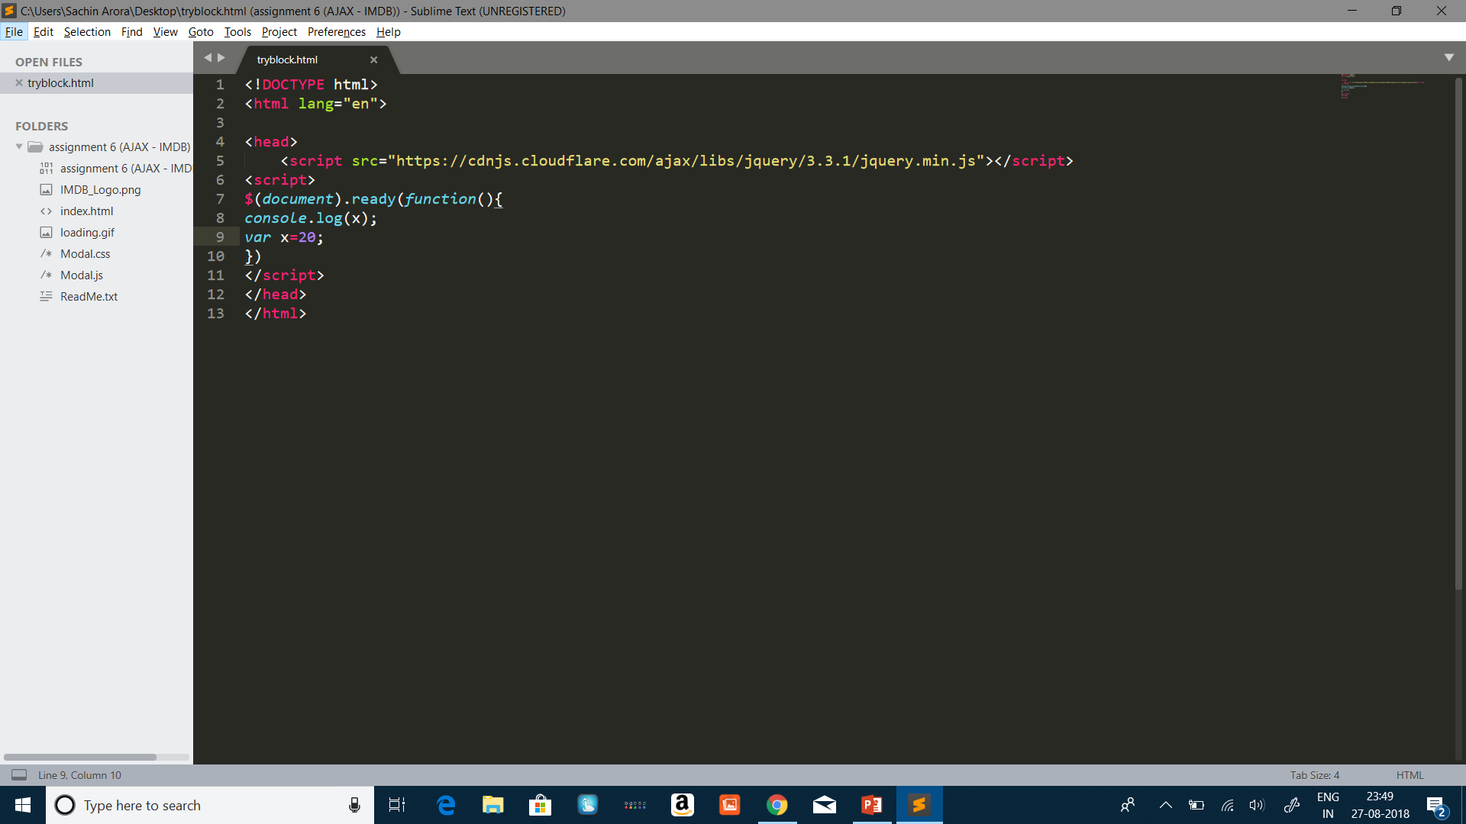
Variable hoisting

Slide 5

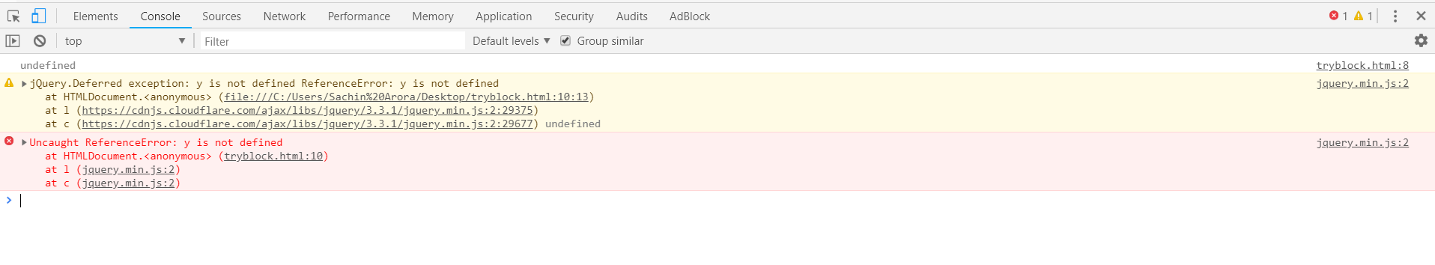

Slide 6
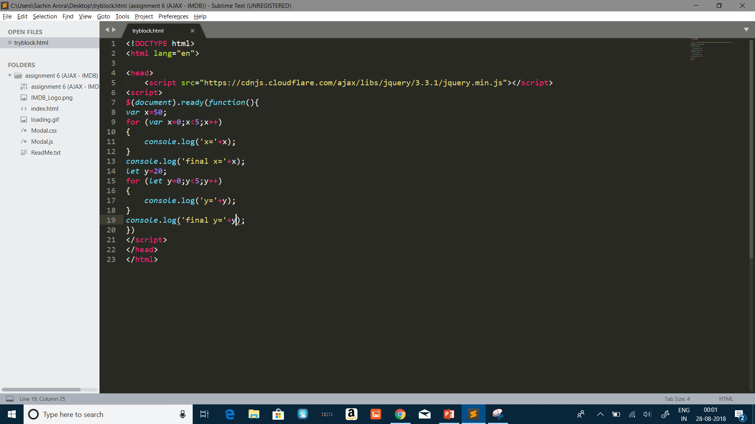


Slide 7


Rest and spread

Slide 8

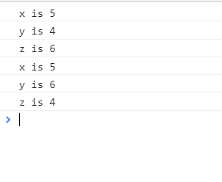
Rest and spread Contd.

Slide 9

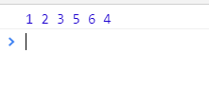
Rest and spread contd.

Slide 10

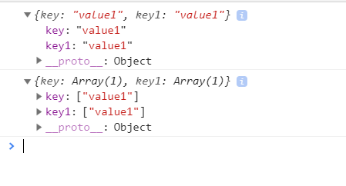
Object literals

Slide 11

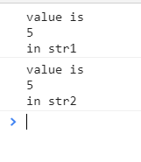
Template literal

Slide 12
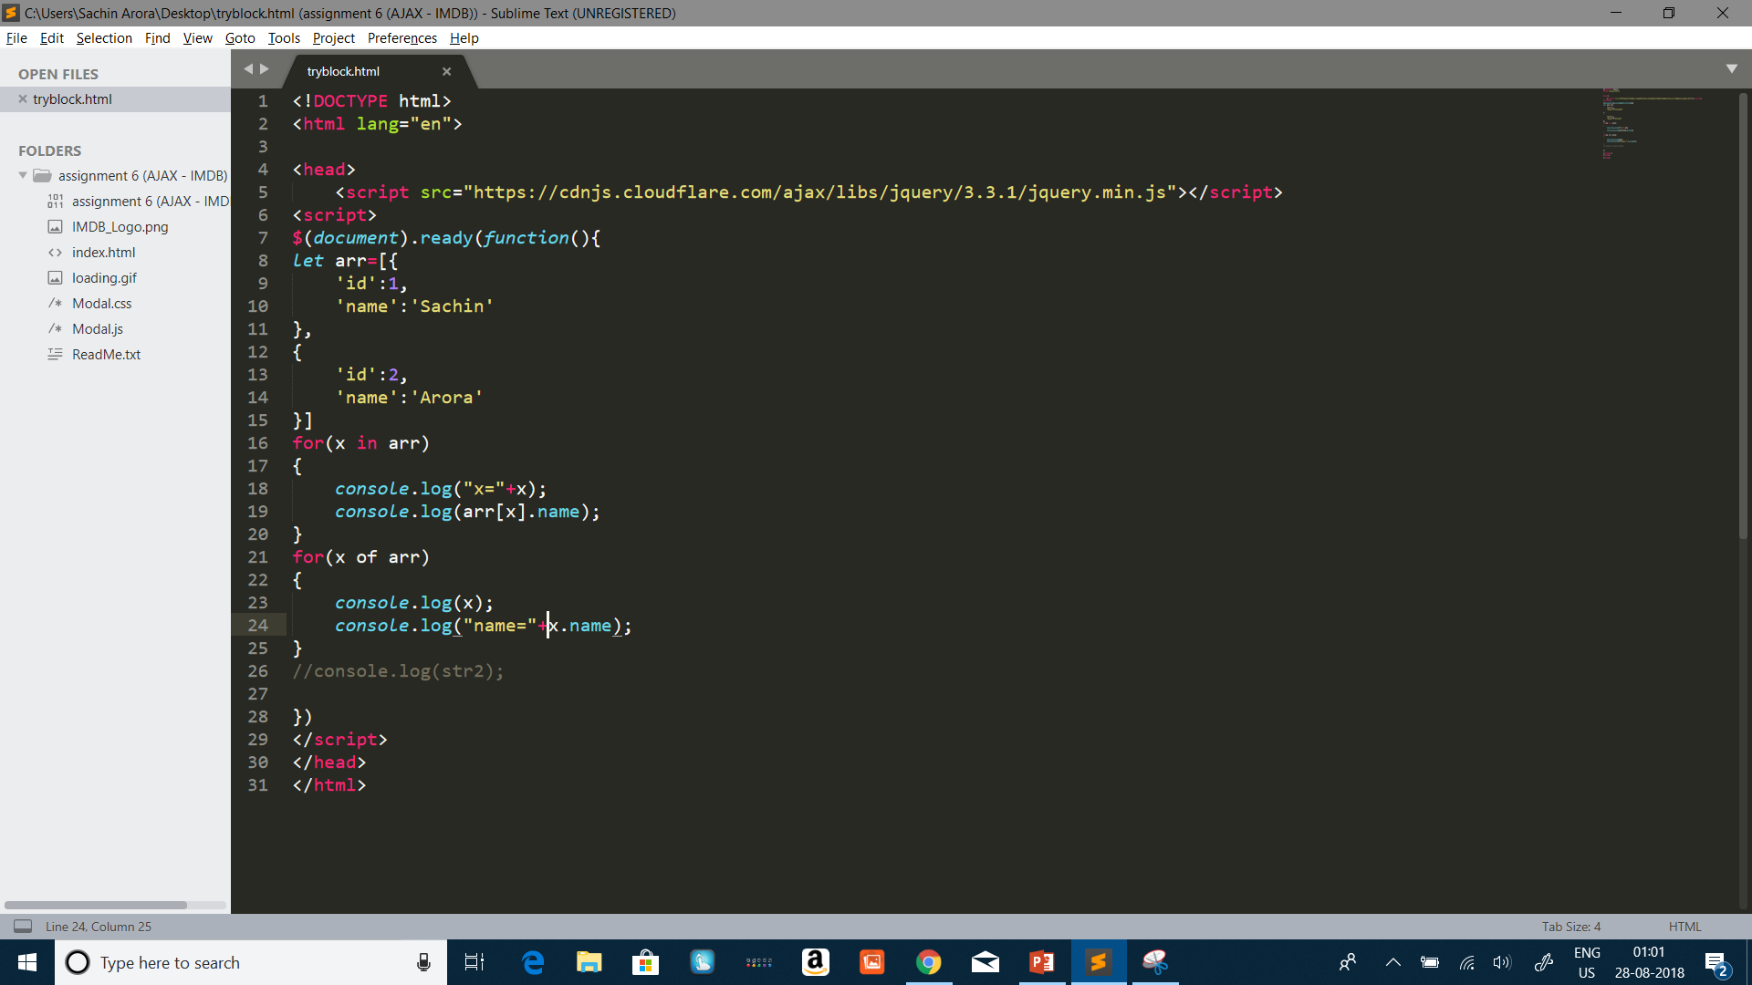
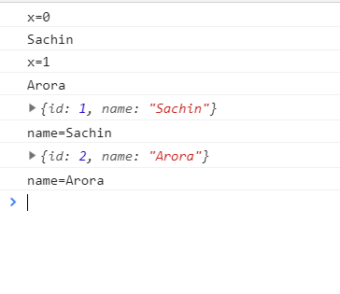
For in and for of loop

Slide 13
Other Features
Arrow Functions
Default parameters
Const keyword

Slide 14


